Slide 1
Shutter Plug Moqup
By: Shadowfax

Slide 2
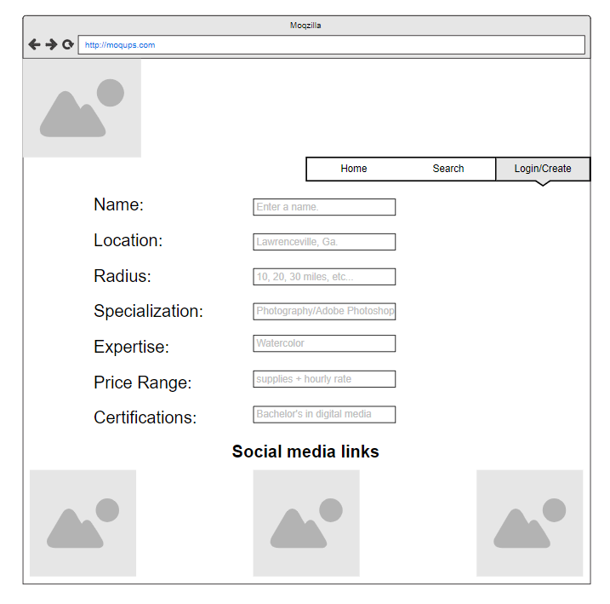
Landing Page (Web)

Slide 3
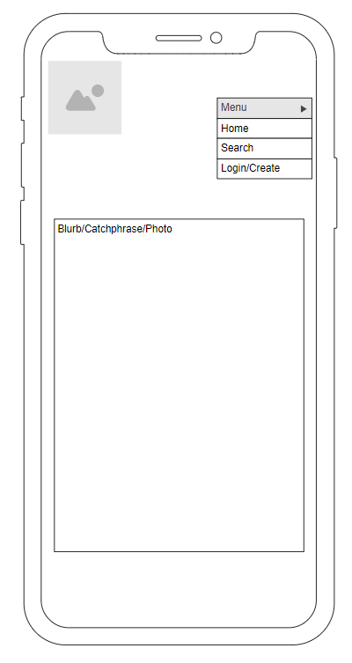
Landing Page(Phone)

Slide 4
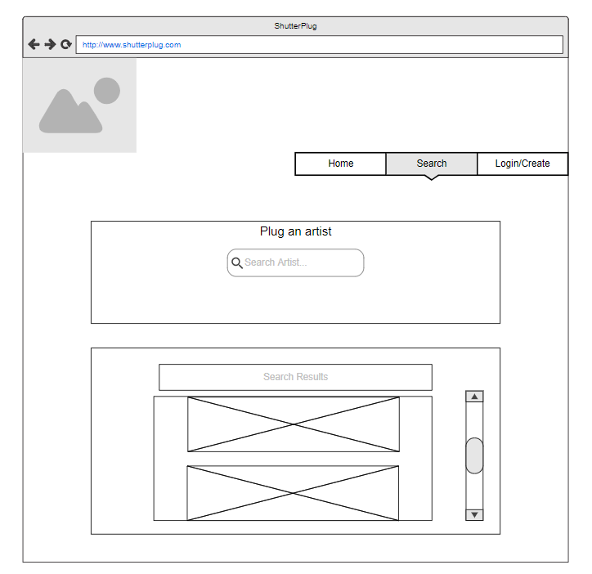
Search and Results(Web)

Slide 5
Create Profile(Web)

